Slide 1
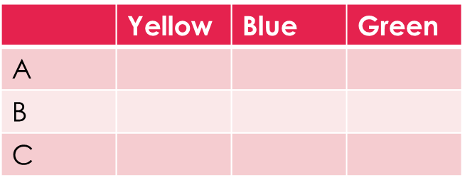
Topic: Tree Diagrams EQ: How can we show two –step problems with tree diagrams?
Steps to be successful this lesson:
Get materials out (notebook, pen, pencil, ruler, calculator)
Rule up notebook and write Topic and EQ
Start on review questions →
Check your answers with someone sitting next to you
Is your notebook up to date? (Contents page, glossary, review notes etc.)
Review questions (on LHS)
There is a bag with 3 marbles (yellow, blue, green) and 3 pieces of paper with letters (A, B, C). Complete the two way table:
P(yellow and A) =
P(complement of Blue) or P(B’) =
P(C) =

Slide 2
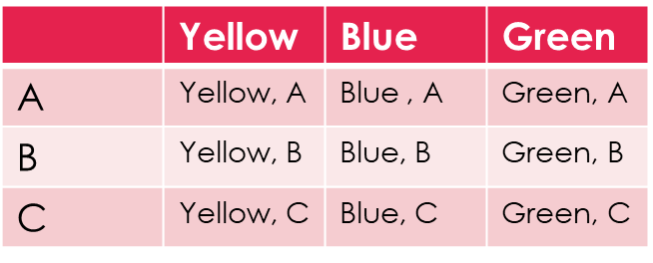
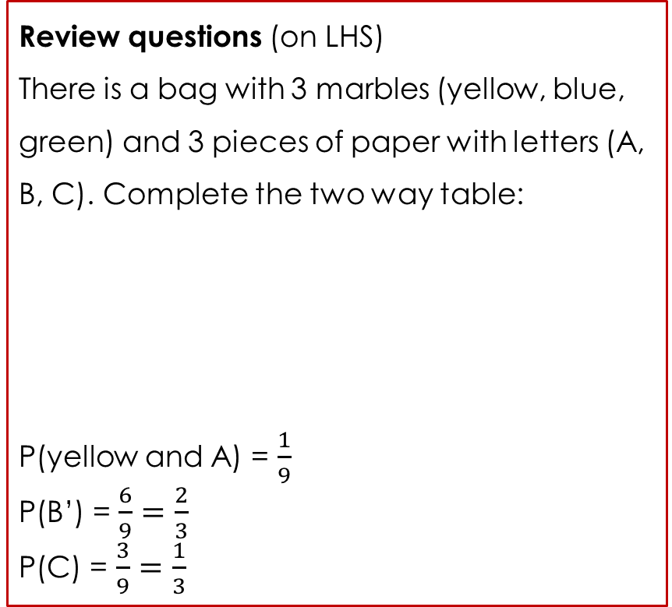
Topic: Tree Diagrams EQ: How can we show two –step problems with tree diagrams?
Review questions (on LHS)
There is a bag with 3 marbles (yellow, blue, green) and 3 pieces of paper with letters (A, B, C). Complete the two way table:
P(yellow and A) = $\frac{1}{9}$
P(B’) = $\frac{6}{9}=\frac{2}{3}$
P(C) = $\frac{3}{9}=\frac{1}{3}$
Steps to be successful this lesson:
Get materials out (notebook, pen, pencil, ruler, calculator)
Rule up notebook and write Topic and EQ
Start on review questions →
Check your answers with someone sitting next to you
Is your notebook up to date? (Contents page, glossary, review notes etc.)

Slide 3
Tree Diagrams Probability Lesson 3
Year 9

Slide 4
24
7
30
Topic: Tree Diagrams
Date:
EQ – How can we show two step problems with tree diagrams?
What is a tree diagram?
Tree diagrams are another useful way of creating representations of multi step events. Each outcome is represented on a “branch”
For a coin toss we can have a heads or a tails. What happens if we toss two coins?

Slide 5
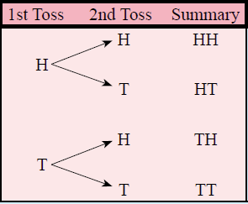

24
7
30
Topic: Tree Diagrams
Date:
EQ – How can we show two step problems with tree diagrams?
What is a tree diagram?
Tree diagrams are another useful way of creating representations of multi step events. Each outcome is represented on a “branch”
For a coin toss we can have a heads or a tails. What happens if we toss two coins?

Slide 6
24
7
30
Topic: Tree Diagrams
Date:
EQ – How can we show two step problems with tree diagrams?
What is a tree diagram?
Tree diagrams are another useful way of creating representations of multi step events. Each outcome is represented on a “branch”
For a coin toss we can have a heads or a tails. What happens if we toss two coins?

Slide 7
24
7
30
Topic: Tree Diagrams
Date:
EQ – How can we show two step problems with tree diagrams?
What is a tree diagram?
Tree diagrams are another useful way of creating representations of multi step events. Each outcome is represented on a “branch”
For a coin toss we can have a heads or a tails. What happens if we toss two coins?
4 outcomes
Heads then Heads = 0.25
Heads then Tails = 0.25
Tails then Heads = 0.25
Tails then Tails = 0.25
What is the probability of getting one of these outcomes?

Slide 8


Slide 9
Activity: Class based tree diagram
Step 1. Organise yourself into two groups– Short hair and Log hair. Short hair people on the left, long hair on the right.
Notes:
Dark hair, not dark hair
Short hair, long hair
Alternatives: boy / girl, shorts/pants

Slide 10
Activity: Class based tree diagram
Next, in your groups, split into two smaller groups: Light and dark hair colours
Number of Short hair
Number of Long hair
5

Slide 11
Activity: Class based tree diagram
Outcome
Light hair
Short and Light hair
Short hair
Dark hair
Short and Dark hair
Long and Light hair
Light hair
Long hair
Long and Dark hair
Dark hair
5

Slide 12
Activity: Class based tree diagram
In your note books, record down the number of people in each of the four groups, then find out the probability of each group.
Remember:
Number in group / Total members in class.

Slide 13




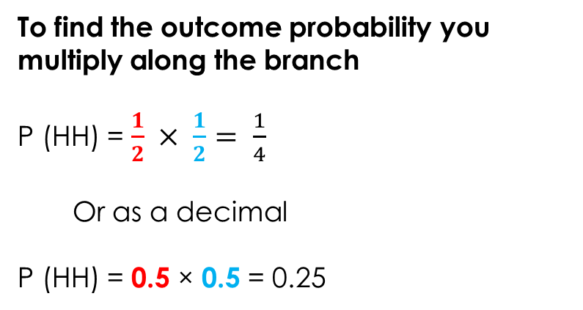


24
7
30
Topic: Tree Diagrams
Date:
EQ – How can we show two step problems with tree diagrams?
Using the same example as before:
What was the probability of getting heads or tails for the first toss?
We know these are the 4 outcomes
Heads then Heads = 0.25
Heads then Tails = 0.25
Tails then Heads = 0.25
Tails then Tails = 0.25
How do you calculate the probability from a tree diagram?
What was the probability of getting heads or tails for the second toss?
$$\frac{1}{2}$$
To find the outcome probability you multiply along the branch
P (HH) = $\frac{1}{2} × \frac{1}{2}= \frac{1}{4}$
Or as a decimal
P (HH) = 0.5 × 0.5 = 0.25
$$\frac{1}{2}$$
$$\frac{1}{2}$$
$$\frac{1}{2}$$
$$\frac{1}{2}$$
$$\frac{1}{2}$$

Slide 15
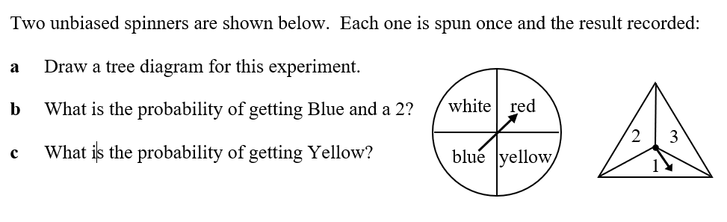






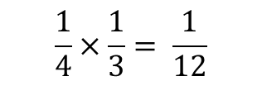



Worked Example
White
Red
Blue
Yellow
1
2
3
1
2
3
1
2
3
1
2
3
$$\frac{1}{4}$$
$$\frac{1}{4}$$
$$\frac{1}{4}$$
$$\frac{1}{4}$$
$$\frac{1}{3}$$
$$\frac{1}{3}$$
$$\frac{1}{3}$$
$$\frac{1}{3}$$
$$\frac{1}{3}$$
$$\frac{1}{3}$$
$$\frac{1}{3}$$
$$\frac{1}{3}$$
$$\frac{1}{3}$$
$$\frac{1}{3}$$
$$\frac{1}{3}$$
$$\frac{1}{3}$$
$$\frac{1}{4}×\frac{1}{3}= \frac{1}{12}$$
P {Blue and 2} =
P{Yellow} =
$$\frac{1}{4}$$

Slide 16
